Slide 1
^{Chapter 3} Recursion and Quicksort
ZAMAN UNIVERSITY
Data Structures and Algorithms

Slide 2
Outline
Recursion
Applied Recursion
Quicksort
Improving Quicksort

Slide 3
Outline
Recursion
Applied Recursion
Quicksort
Improving Quicksort

Slide 4
Recursion
Recursion is one of the most interesting, and surprisingly effective, techniques in programming
Recursion is a programming technique in which a function calls itself

Slide 5
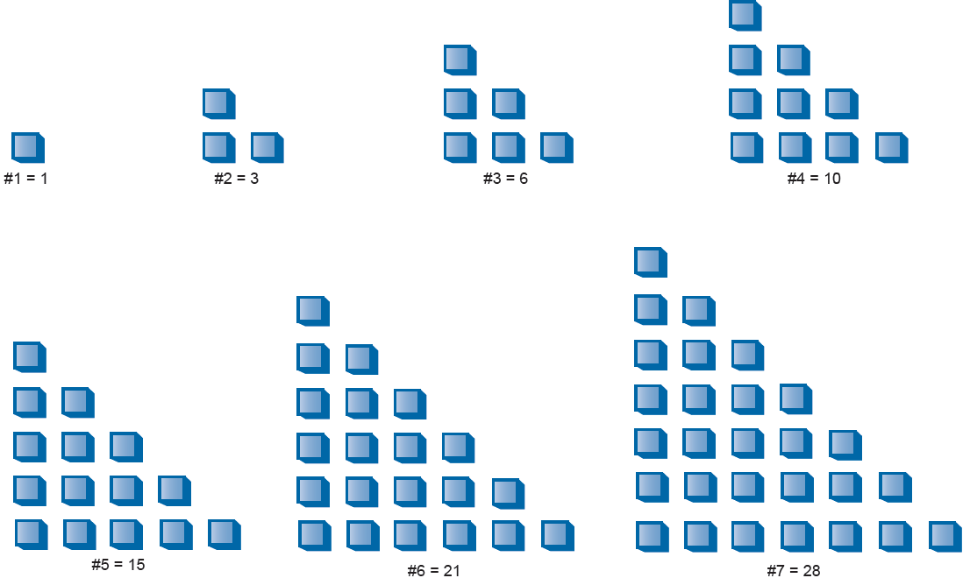
Recursion: Demonstrating Recursion with Triangular Numbers
The n^{th} term in the series is obtained by adding n to the previous term
Thus the second term is found by adding 2 to the first term (which is 1), giving 3.
The third term is 3 added to the second term giving 6, and so on.

Slide 6
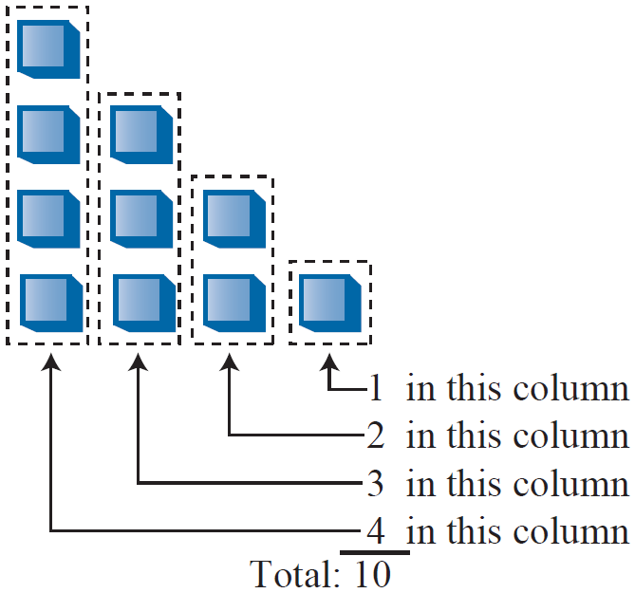
Recursion: Finding the n^{th} Term Using a Loop
In the 4th term, the first column has four little squares, the second column has three, and so on Adding 4+3+2+1 gives 10.
int triangle( int n ) {
int total = 0;
while( n > 0 ) { //until n is 1
total = total + n; //add n (column height) to total
--n; // decrement column height
}
return total;
}

Slide 7
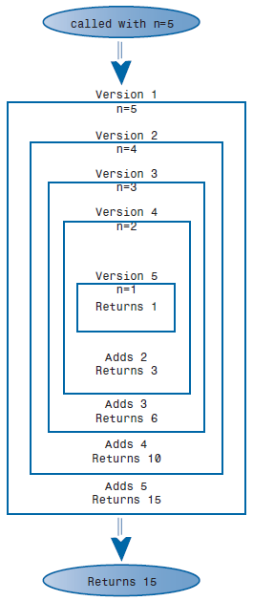
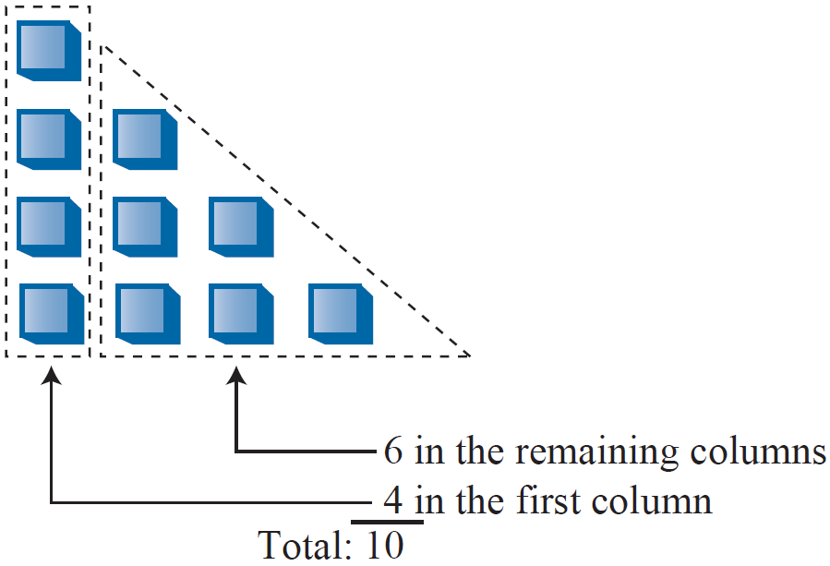
Recursion: Finding the n^{th} Term Using Recursion
The loop approach might seem straightforward, but there’s another way to look at this problem
The value of the n^{th} term can be thought of as the sum of only two things, instead of a whole series. These are:
The first (tallest) column, which has the value n
The sum of all the remaining columns
int triangle( int n) {
if( n==1 )
return 1;
else
return( n + triangle(n-1) );
}

Slide 8
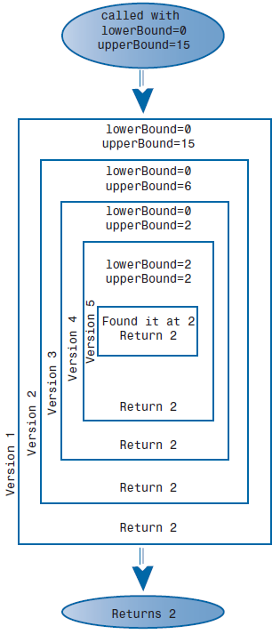
Recursion: Using Recursion in a Binary Search
int recFind(double Key, int lower, int upper){
curIn = (lower + upper ) / 2;
if( v[curIn]==Key ) return curIn; //found it
else if( lower > upper) return -1; //can’t find it
else { //divide range
if( v[curIn] < Key ) //it’s in upper half
return recFind(Key, curIn+1, upper);
else //it’s in lower half
return recFind(Key, lower, curIn-1);
} //end else divide range
} //end recFind()
10, 23, 27, 34,…,99
Key = 27

Slide 9
Recursion: Understanding Divide-and-Conquer Algorithms
The recursive binary search is an example of the divide-and-conquer approach
The big problem divided into two smaller problems and solve each one separately
The process continues until you get to the base case, which can be solved easily, with no further division into halves
A divide-and-conquer approach usually involves a function that contains two recursive calls to itself, one for each half of the problem
In the binary search, there are two such calls, but only one of them is actually executed.

Slide 10


Write a program that uses recursion:
1. for Binary Search;
2. to calculate the factorial of a number.

Slide 11
Outline
Recursion
Applied Recursion
Quicksort
Improving Quicksort

Slide 12
Applied Recursion: Mergesort
Mergesort is more efficient sorting technique than Bubble and Insertion sort, in term of time
Bubble and Insertion take O(N²) time, the mergesort is O(N*logN)
For example: if N is 10,000, then N² is 100,000,000, where as N*logN is 40,000. Thus, if sorting this many items required 40 Seconds with the mergesort, it would take almost 28 hours for the insertion sort
The mergesort is also fairly easy to implement, it’s conceptually easier than quicksort

Slide 13
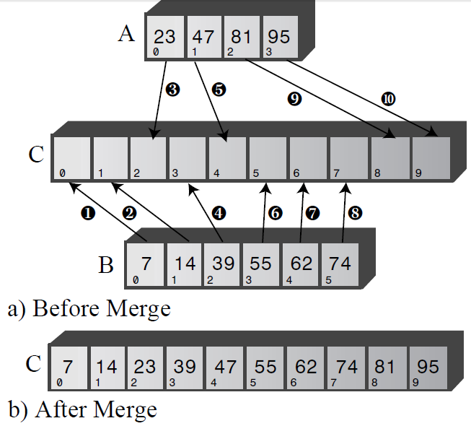
Merge Two Sorted Arrays
Merging of two sorted arrays A and B to C, that contains all the elements of A and B, also arranged in sorted order
Step | Comparison | Copy
1 | Compare 23 and 7 | Copy 7 from B to C
2 | Compare 23 and 14 | Copy 14 from B to C
3 | Compare 23 and 39 | Copy 23 from A to C
4 | Compare 39 and 47 | Copy 39 from B to C
5 | Compare 55 and 47 | Copy 47 from A to C
6 | Compare 55 and 81 | Copy 55 from B to C
7 | Compare 62 and 81 | Copy 62 from B to C
8 | Compare 74 and 81 | Copy 74 from B to C
9 |  | Copy 81 from A to C
10 |  | Copy 95 from A to C

Slide 14
Recursion: Sorting by Merging
Mergesort is to divide an array in half, sort each half, and then merge the two halves into a single sorted array
How do you sort each half?
Half array divide into two quarters, sort each of the quarters, and merge them to make a sorted half
You divide the array again and again until you reach a subarray with only one element. The one element is already sorted.

Slide 15
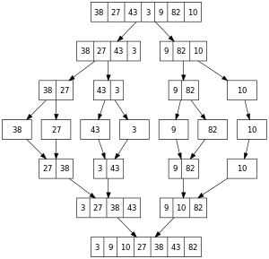
//Result of Sorted Array A will be written in Array B
RecMergeSort(int A[], int lowerBound, int upperBound, int B[]) {
if(lowerBound == upperBound) //if range is 1,
return; //no use sorting
else { //find midpoint
int mid = (lowerBound+upperBound) / 2;
//sort low half
RecMergeSort(A, lowerBound, mid, B);
//sort high half
RecMergeSort(A, mid+1, upperBound, B);
//merge lowerBound->mid and mid+1->upperBound to B
merge(A, lowerBound, mid+1, upperBound, B);
} //end else
} //end recMergeSort()

Slide 16
Write a program:
1. Merge of two sorted Arrays;
2. Use recursion to create mergesort function.

Slide 17
Outline
Recursion
Applied Recursion
Quicksort
Improving Quicksort

Slide 18
Quicksort
The bubble and insertion sorts — are easy to implement but are rather slow
Mergesort is applied recursion, it runs much faster than the simple sorts, but requires twice space as original array
Quicksort runs faster than simple sorts, in O(N*logN) time, it does not require a large amount of extra memory space, as mergesort
Quicksort is based on the idea of partitions

Slide 19
Quicksort: Partitioning
To partition data is to divide it into two groups:
all the items with a key value higher than a specified amount;
All the time with a lower key value.
Examples
Maybe you want to divide your personnel records into two groups: employees who live within 15 miles of the office and those who live farther away
A school administrator might want to divide students into those with grade point averages higher and lower than 3.5, so as to know who deserves to be on the dean’s list

Slide 20
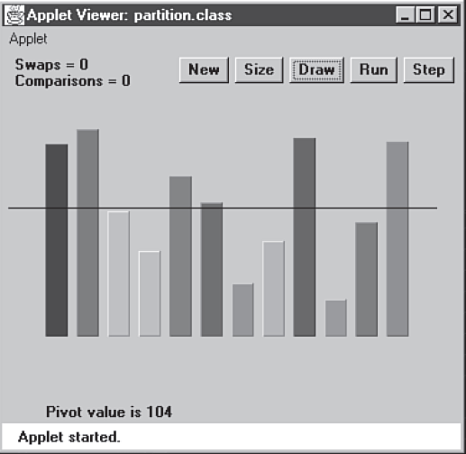
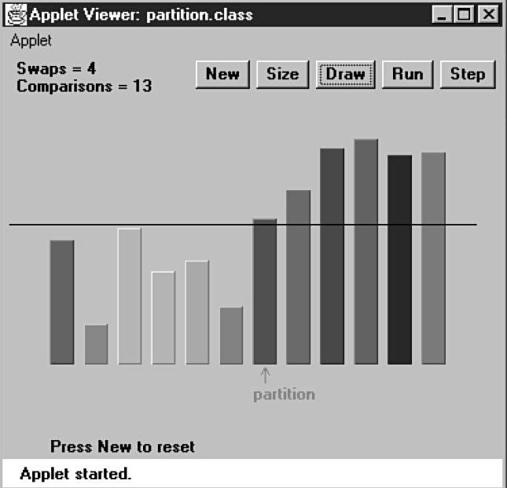
Quicksort: Partitioning Example
Pivot – is the value used to determine into two groups (less and greater). It is the border of less than and greater.
Twelve Bars Before Partitioning
Twelve Bars After Partitioning

Slide 21
Quicksort: Partitioning Pseudo Code
int PartitionIt( left, right, pivot) {
while( true ){
find the element greater than pivot; //find to the right, but //possible greater than right element
find the element smaller than pivot; //find to the left, but possible //less than the left element
if the index of left cross to right //partition done
then partition done (break);
else swap( LeftMark, RightMark );
}
swap( LeftMark, Pivot)//swap the element in index LeftMark with Pivot
return LeftMark;
}

Slide 22
Basic Quicksort
Quicksort was discovered by British Computer Scientist C. A. R. Hoare, 1962
Basically the quicksort algorithm operates by partitioning an array into two sub-arrays, and then calling itself recursively to quicksort each of these sub-arrays
The pivot will be selected at right, but it will be finally placed between these two sub-arrays

Slide 23
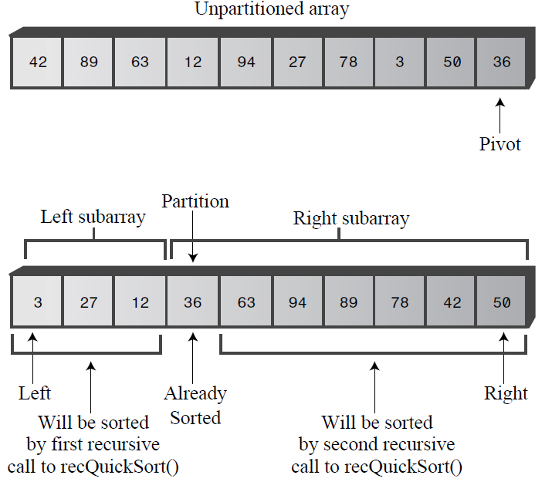
Quicksort: Recursive Calls Sort Subarrays

Slide 24
Quicksort: Pseudo Code
recQuickSort(left, right) {
if Array has only element
return; //already sorted
else { //size is 2 or larger
pivot is the right element of Array //rightmost item
//partition range
partition <- PartitionIt(left, right, pivot);
recQuickSort(left, partition-1); //sort left side
recQuickSort(partition+1, right); //sort right side
}
} // end recQuickSort()

Slide 25
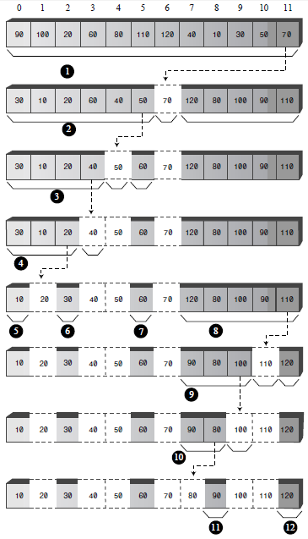
Quicksort Process

Slide 26
Write a program:
1. to partition Array;
2. Use recursion to create Quicksort function.

Slide 27
Outline
Recursion
Applied Recursion
Quicksort
Improving Quicksort

Slide 28
Problems with Inversely Sorted Data
If we use quicksort to sort 100 inversely sorted items, the algorithm runs much more slowly
During partitioning, pivot will be larger then sub-arrays
Pivot should be larger than half array, and smaller than half array
Two equal sub-arrays is the optimum situation for the quicksort algorithm
The worst situation results when a subarray with N elements is divided into one subarray

Slide 29
How to Select Pivot?
The pivot should be the median of the items being sorted
The median or middle item is the data item chosen, it will be divided half smaller and half larger
Choosing pivot at random is simple but it does NOT always result in a good selection
The method should be simple but have a good chance of avoiding the largest or smallest value
Thus, the pivot should be selected by Median-of-Three

Slide 30
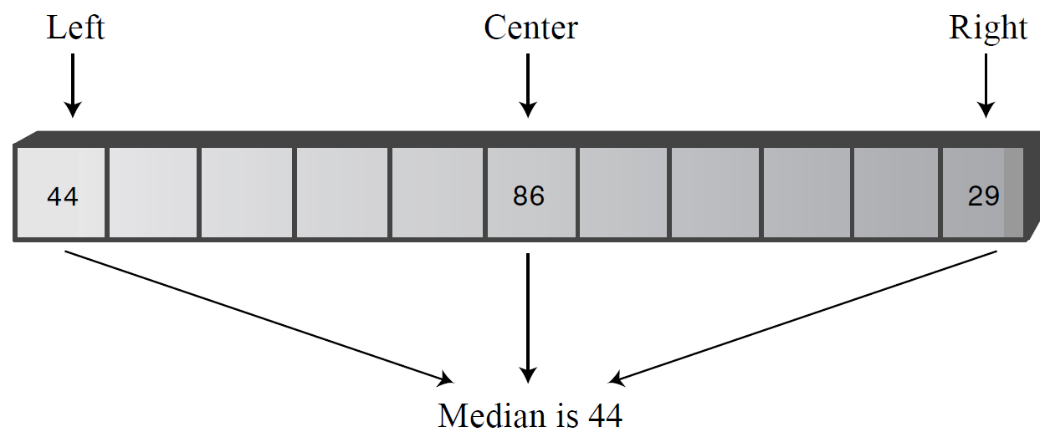
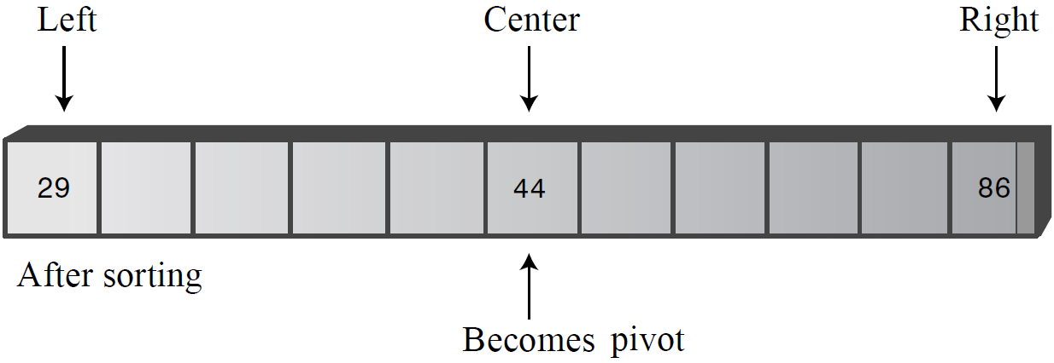
Median-of-Three Partitioning
A compromise solution is to find the median of the first, last, and middle elements of the array, and use this for the pivot
This is called the median-of-three
During finding median, the three element should be sorted (which the smallest is in left, largest is in right, and pivot is in center)

Slide 31
Handling Small Partitions
If you use the median-of-three partitioning scheme, it will not work for partitions of three or fewer items
For example, after partitioning we have sub-arrays of 2 and 3 items
In this case, for the sub-arrays use manual sorting
Knuth* recommends using insertion sort, in case if number item of array is 9
* - The Art of Computer Programming by Donald E. Knuth, of Stanford University (Addison Wesley, 1997)

Slide 32
Write a QuickSort program which is:
1. pivot is selected by median-of-three;
2. and using insertion sort for sub-arrays, which is number items 2 or 3.

Slide 33
End of Chapter 3

